Slide 1





Muhammad Hammad
(Senior Software Engineer)

Slide 2

Agenda
.NET Framework
.NET Framework Architecture
.NET Core
.NET Framework v/s .NET Core
.NET Full stack
Notes:
It provides an abstraction to manage the system complexity and establish a communication and coordination mechanism among components.

Slide 3
Why .NET is called .NET ?
The early marketing thrust of .NET was web services and networking.
Just like there was dotcom word in early 2000s. Microsoft used as a marketing strategy.
.NET was supposed to make it easy both to write and consume web services.
In particular, it was supposed to make it easier to call the web services that Microsoft was going to provide, and that everyone would then use: the ".NET My Services".

Slide 4
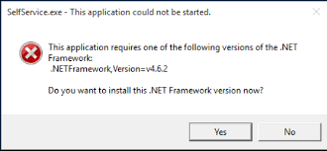
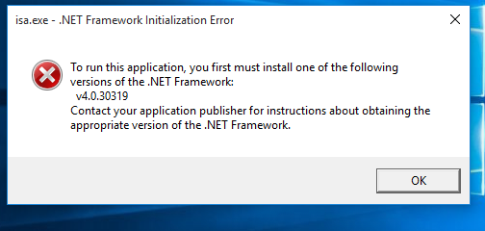
What is .NET Framework?

Slide 5
What is .NET Framework?
“a platform that offers services”

Slide 6
What is .NET Framework?
NET Framework is a software development framework for building and running applications on Windows.
It is a framework for developing web-based and windows-based applications within the Microsoft environment.
It was specifically used for the development of WinForms, ASP.NET & ADO.NET applications.
It was suppressed by the cross-platform .NET core project.

Slide 7
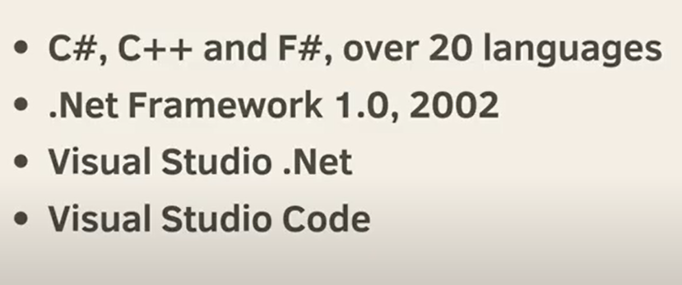
What is .NET Framework?

Slide 8
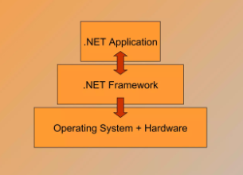
Abstract Architecture of .NET Framework

Slide 9
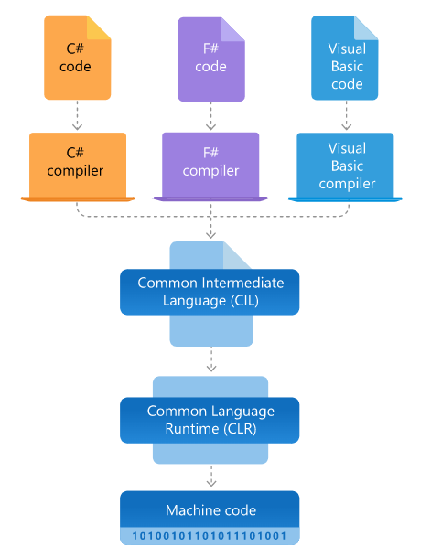
Detailed Architecture of .NET Framework

Slide 10
Code Compilation Process
.NET code is not directly compiled to Machine Code.
It is a first complied to IL (intermediate Language)
CLR (Common Language Runtime) accept IL which compiles code to Machine code.
The Recompilation is JIT (Just in time). Which is done as soon as a function is or sub routine is called.

Slide 11
What is .NET Core?
.NET Core is a new version of .NET Framework, which is a free, open-source, general-purpose development platform maintained by Microsoft. It is a cross-platform framework that runs on Windows, macOS, and Linux operating systems.
.NET Core Framework can be used to build different types of applications such as mobile, desktop, web, cloud, IoT, machine learning, microservices, game, etc.

Slide 12
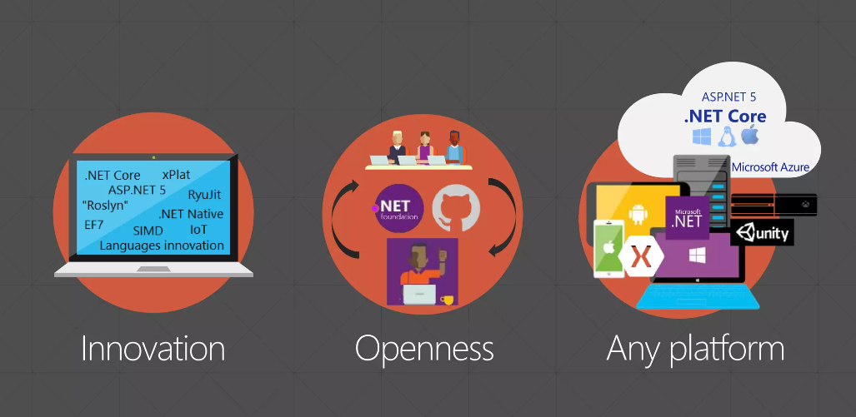
.NET CORE

Slide 13
.NET CORE

Slide 14

.NET CORE

Slide 15
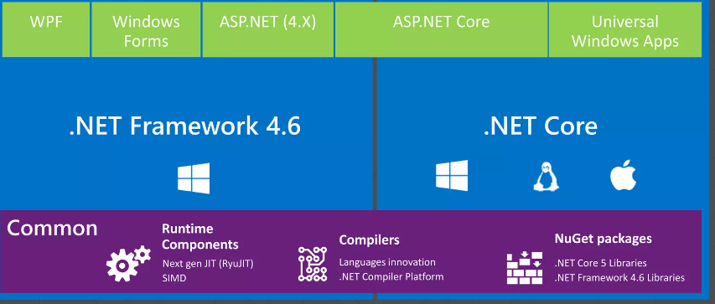
What’s Common What’s not ?

Slide 16
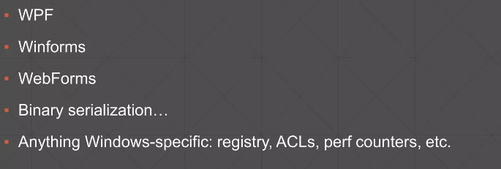
What’s not Supported

Slide 17
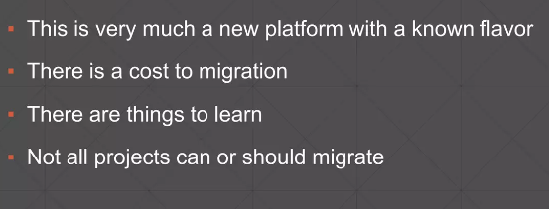
Managing Expectations

Slide 18
Managing Expectations

Slide 19
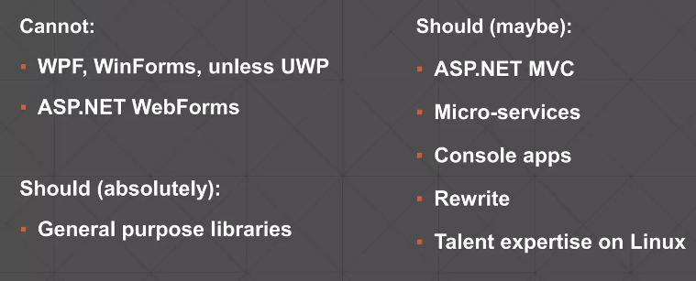
Should I migrate my Project?

Slide 20
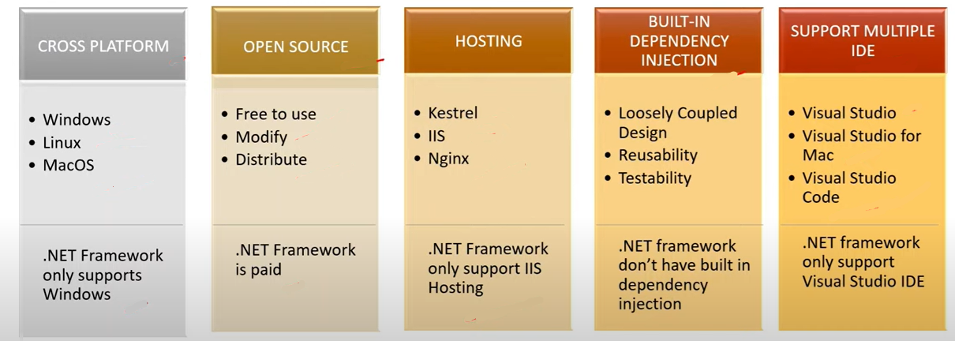
.NET Framework v/s .NET Core?

Slide 21
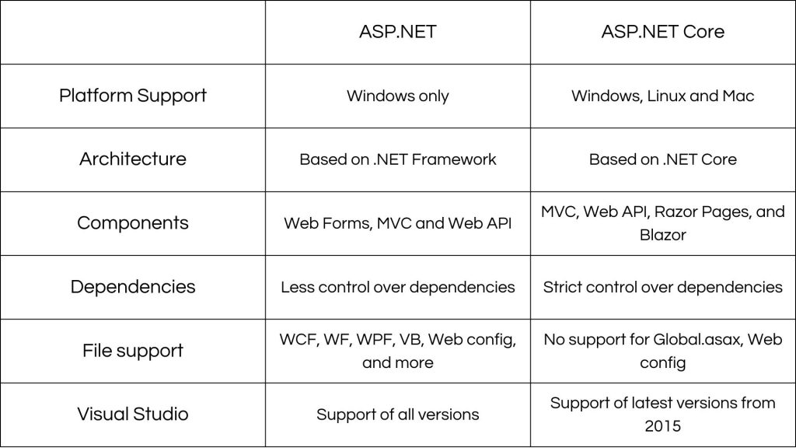
.NET Framework v/s .NET Core?

Slide 22
Current Versions
Its now called .NET (previously named as .NETCORE)
Current Version = 7.0.0 (Release on 8th November 2022)
.NET Framework final version (4.8.1) was released 3 months ago. No new versions are planned.
So, better focus on learning .NET Core over Framework
Notes:
It provides an abstraction to manage the system complexity and establish a communication and coordination mechanism among components.

Slide 23
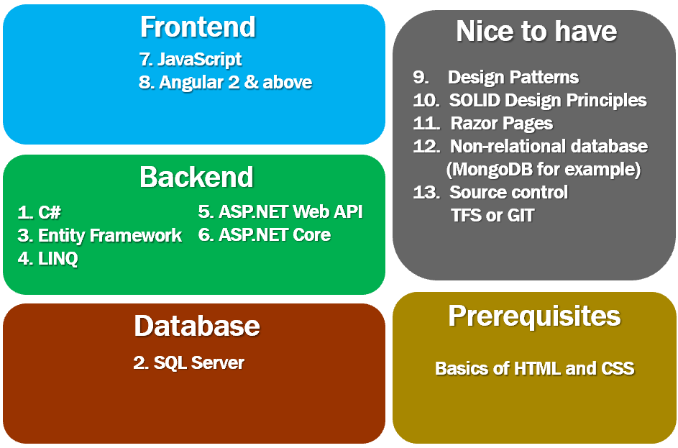
.NET Full stack

Slide 24
Thank You

